Slide 1
EDEX - COLLEGE ERP SYSTEM

Slide 2
Group Members:
Mr. Jarvis Silva (2105016)
Mr. Anandhu Rengan (2105101)
Mr. Abhishek Verma (2105002)
Mr. Anish Pratap Parsekar (2105104)
Mr. Kanishk Singh Negi (2105017)
Mr. Nikhil Jaiswal (2105021)
Mr. Soubhagya Ranjan Das (2105117)
Ms. Sonia Sandeep Dhargalkar (2105116)

Slide 3
Introducing Edex
In today's educational landscape, colleges and universities face various challenges in efficiently managing administrative, academic, and operational tasks.
Traditional methods of record-keeping and communication often prove inadequate, leading to inefficiencies and frustrations among stakeholders.
To tackle these challenges, we introduce the Edex College Management System – a modern, comprehensive solution designed to transform how educational institutions handle their day-to-day operations.
Edex provides a centralized platform that streamlines administrative processes, enhances communication, and delivers valuable insights to administrators, faculty members, and students.
From managing courses and classrooms to monitoring attendance and grades, Edex empowers colleges to concentrate on delivering a high-quality education and nurturing student success.

Slide 4
Traditional System
In traditional college management systems, administrative tasks are often carried out manually or through outdated software solutions. This traditional approach presents several challenges:
Manual Record-Keeping: Colleges rely heavily on paper-based record-keeping systems, leading to inefficiencies, data errors, and the risk of information loss.
Limited Accessibility: Access to information and resources is restricted by physical location and office hours, making it difficult for stakeholders to obtain timely updates and support.
Scalability and Flexibility Issues: Traditional systems are often rigid and inflexible, making it difficult to adapt to changing needs, accommodate growth, and scale operations effectively.
Lack of Insights: Without access to real-time data and analytics, colleges struggle to identify trends, track performance metrics, and make data-driven decisions to improve operations and student outcomes.

Slide 5
Proposed System
Course Management: Enable administrators to add, edit, and delete courses within the system, including defining course names, descriptions, durations, and other relevant details. Provide features for managing course enrollments, prerequisites, and scheduling.
Classroom Management: Implement functionalities for creating, editing, and deleting classrooms associated with specific courses. Allow administrators and course heads to assign teachers and students to classrooms and manage classroom-related activities.
Student Management: Enable administrators and course heads to add, edit, and delete student records within the system. Provide features for managing student enrollments, transfers, and academic records.
Subject Management: Implement functionalities for creating, editing, and deleting subjects within specific classrooms. Allow teachers and course heads to assign subjects to classrooms and manage subject-related activities, including curriculum design, lesson planning, and assessment.

Slide 6
Proposed System
Attendance Tracking: Enable teachers and course heads to record and manage student attendance for individual subjects and classrooms. Provide features for generating attendance and monitoring student attendance trends over time.
Exam Management: Implement functionalities for scheduling, conducting, and managing exams within specific classrooms and subjects. Allow teachers to create exam schedules, define exam formats, record exam results, and generate exam reports.
Teacher Management: Enable administrators to add, edit, and delete teacher records within the system.
Provide features for managing teacher assignments, qualifications, and schedules.

Slide 7
USE CASE DIAGRAM

Slide 8
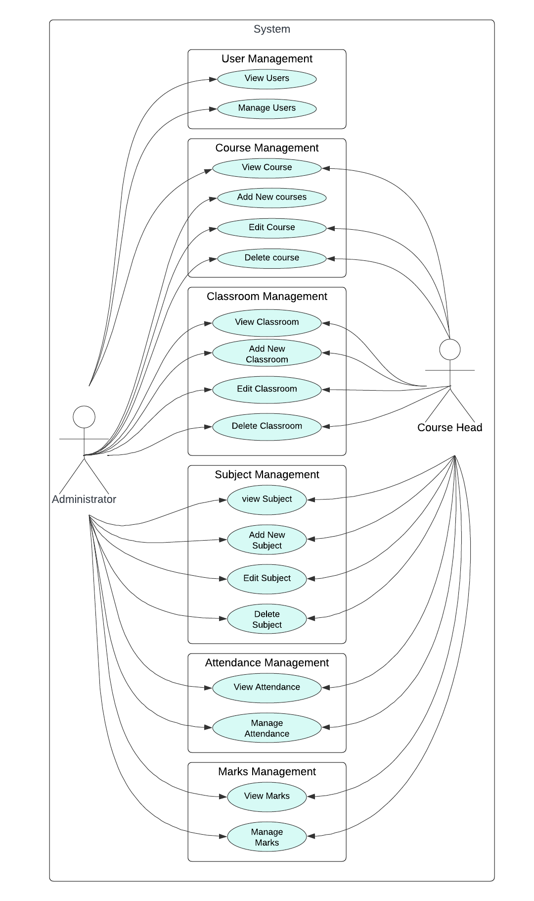
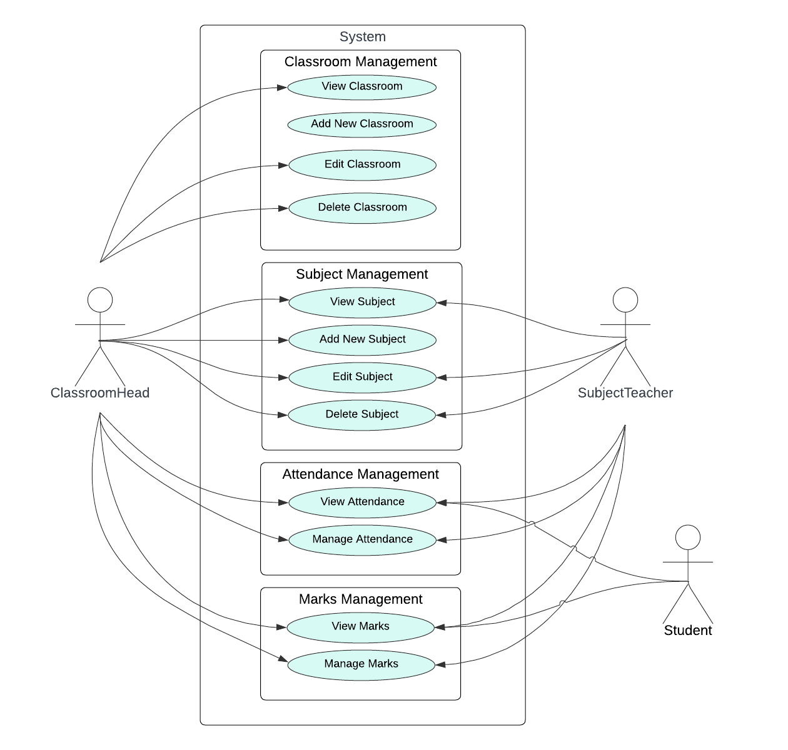

Slide 9
ER DIAGRAM

Slide 10
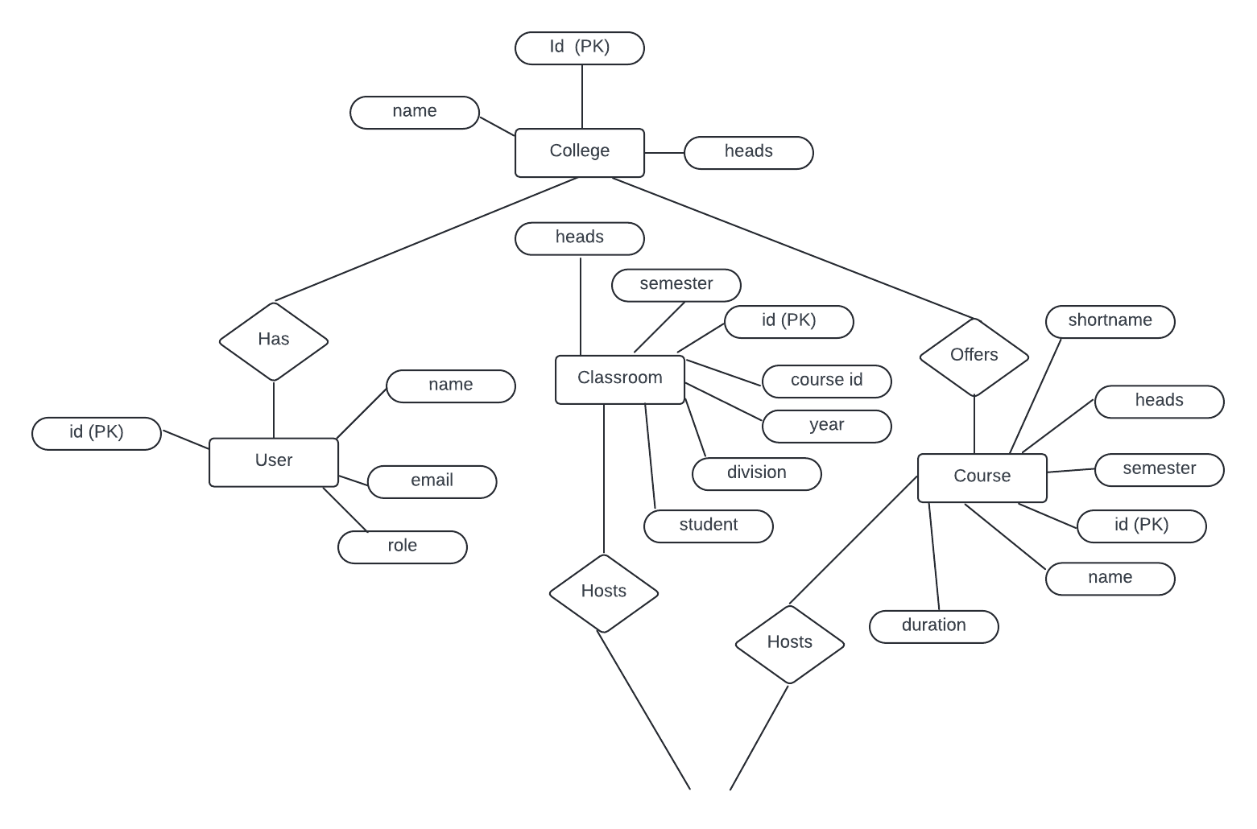
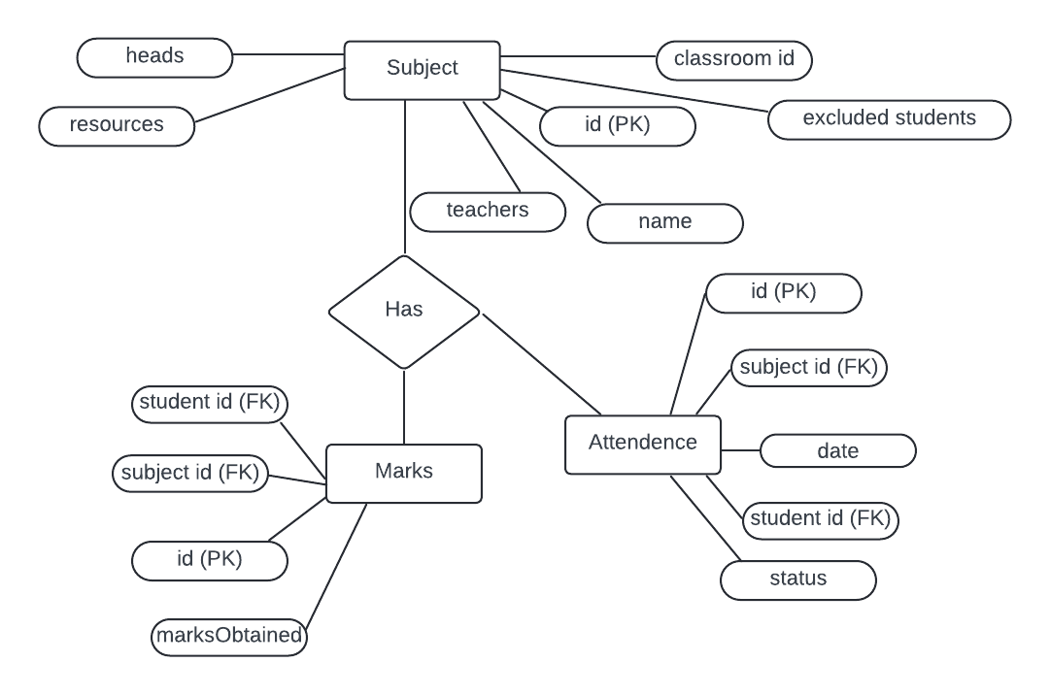

Slide 11
Class Diagram

Slide 12
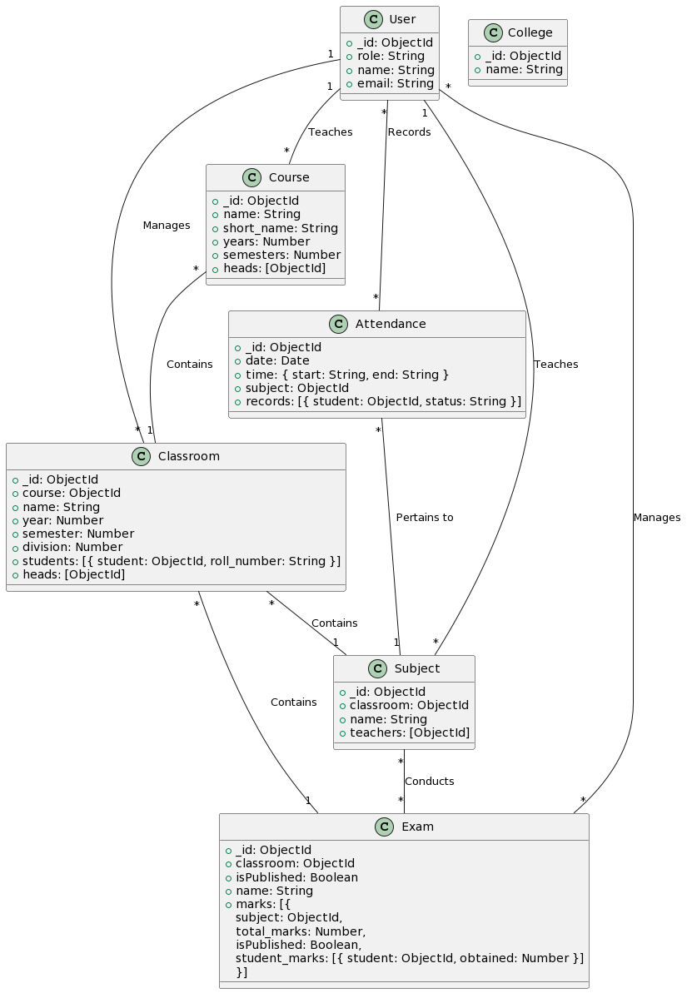

Slide 13
Technologies Used
Next.js: Next.js is a powerful React framework that enables server-side rendering, static site generation, and seamless client-side navigation. It provides excellent performance and SEO benefits, making it ideal for building dynamic web applications.
React.js: React.js is a popular JavaScript library for building user interfaces. It allows developers to create reusable UI components and manage application state efficiently. React's component-based architecture enhances code organization and reusability.
Tailwind CSS: Tailwind CSS is a utility-first CSS framework that streamlines the process of styling web applications. It offers a wide range of pre-built utility classes that developers can use to create custom designs quickly. Tailwind's approach to styling promotes consistency and maintainability across projects.
MongoDB: MongoDB is a flexible and scalable NoSQL database that stores data in JSON-like documents. It provides high performance, horizontal scalability, and rich query capabilities, making it suitable for handling diverse data types and large volumes of data..

Slide 14
Authentication Tech
JSON Web Tokens: , simplifies the authentication process by securely managing user logins. When a user logs in, the server generates a unique token containing the user's information. This token is then sent to the user's browser and stored there. Whenever the user accesses a protected page, such as their profile or dashboard, the browser sends this token along with the request. The server verifies the token's authenticity using a secret key
Nodemailer: It is a popular module for Node.js applications that simplifies the process of sending email messages. It provides an easy-to-use API for sending emails using various transport methods, such as SMTP, sendmail, or Amazon SES. With Nodemailer, developers can send plain text or HTML emails, as well as attachments and inline images. The module is highly configurable, allowing developers to customize email content, add attachments, and specify email headers.

Slide 15
Demo

Slide 16
CONCLUSION:
In conclusion, the Edex College Management System offers a modern and efficient solution to the challenges faced by educational institutions. By providing a centralized platform for managing administrative, academic, and operational tasks, Edex simplifies processes, enhances communication, and improves overall efficiency.
With features such as user management, course management, attendance tracking, and exam management, Edex empowers colleges to streamline their operations and focus on providing a high-quality education to students. By embracing digital transformation and leveraging cutting-edge technologies, Edex paves the way for a brighter future in education, where institutions can thrive and students can succeed.

